Slide 1
ERASMUS

Slide 2
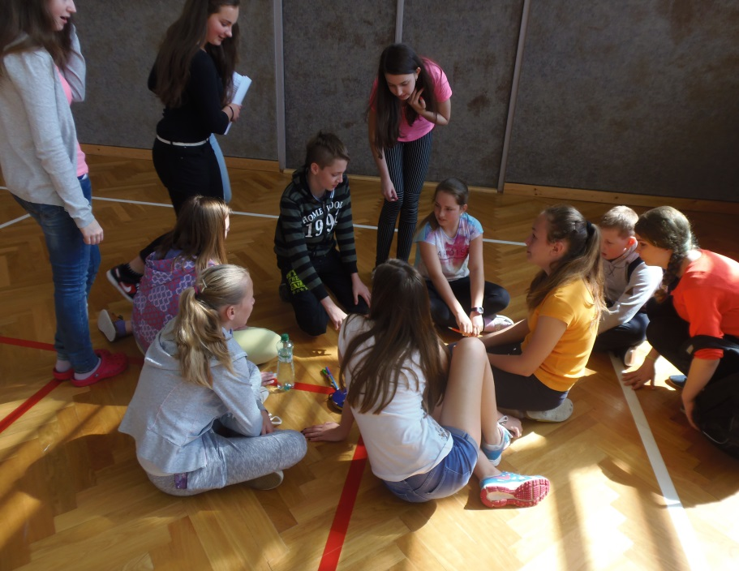
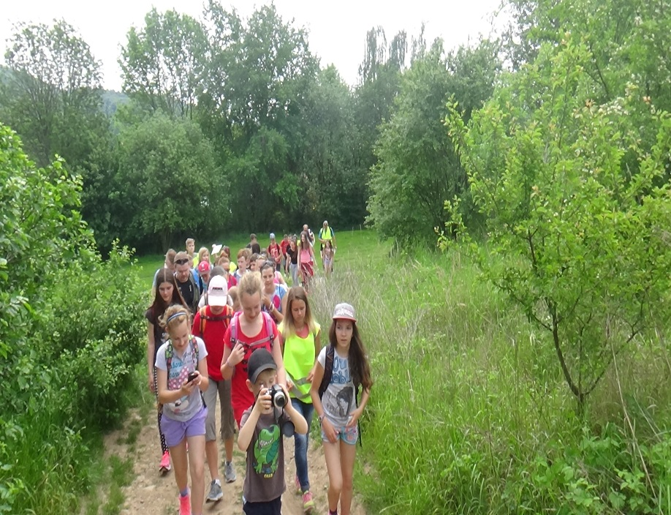
MONDAY - 23.5.
We counted mathematical work in the morning
We were on the trip in the afternoon

Slide 3
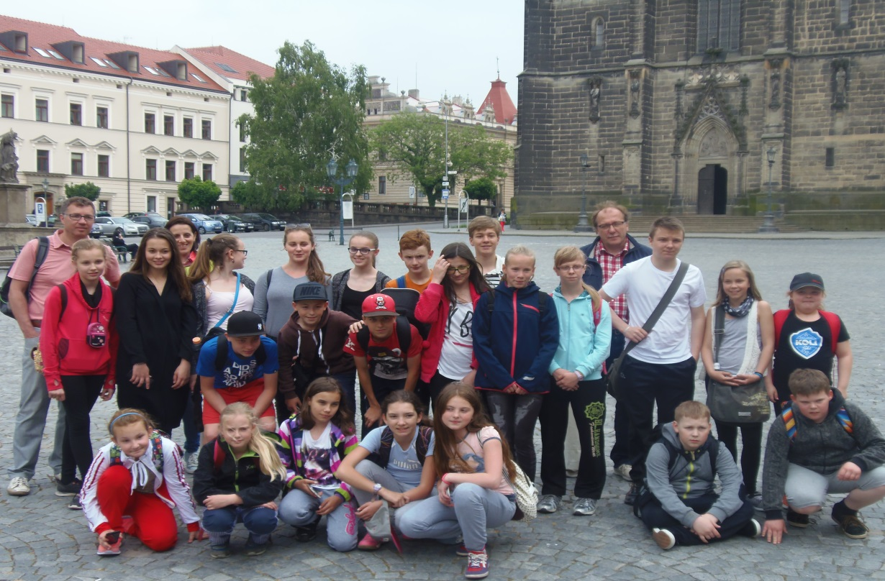
TUESDAY - 24.5.
We play the sports games in the mornig
Finns and Slovaks sample the traditional Czech dish in Chrudim in the afternoon

Slide 4
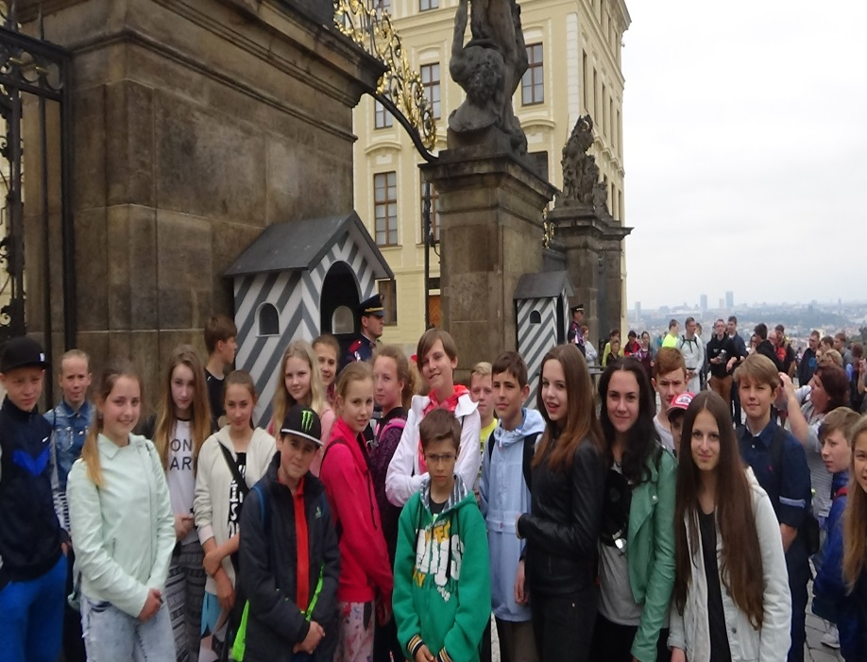
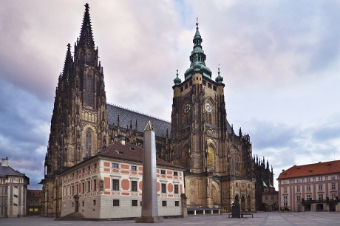
Wednesday - 25.5.
We were on the daylong trip in Prague

Slide 5
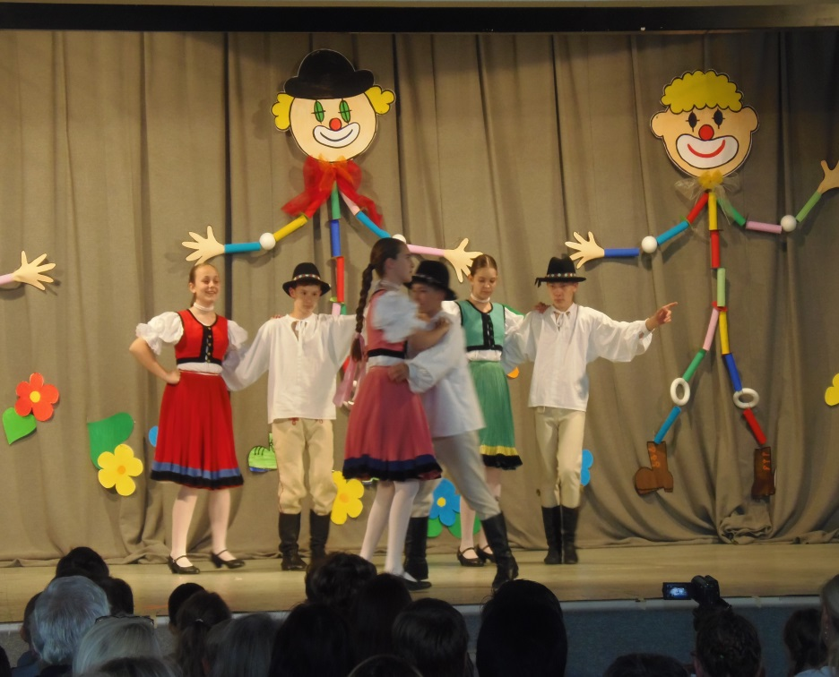
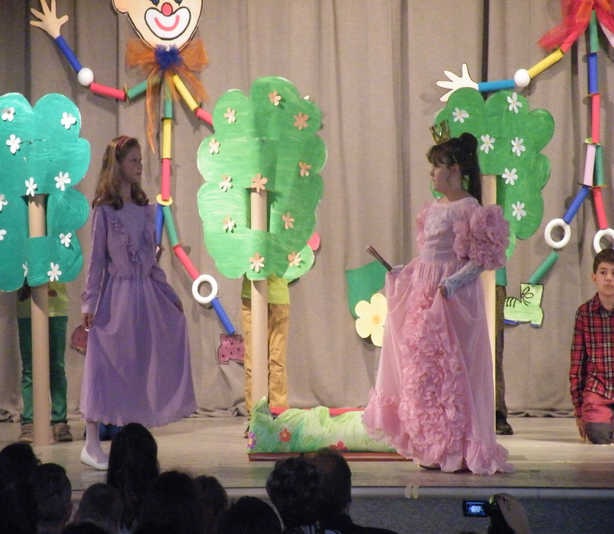
Thursday - 26.5.
Was the school academy

